Slide 1
Travel agent
CAPSTONE PROJECT
Presented By: SOUPTIK KARAR
Student name : SOUPTIK KARAR College Name & Department : MCKV Institute of Engineering-CSE-DS

Slide 2
OUTLINE
Problem Statement
Technology used
Wow factor
End users
Result
Conclusion
Git-hub Link
Future scope
IBM Certifications

Slide 3
Problem Statement
Planning a trip can be a time-consuming and complex task involving the coordination of multiple factors such as destinations, accommodations, transport options, weather conditions, budget constraints, and personal preferences. Traditional travel planning methods often require the use of multiple tools and platforms, leading to inefficiencies, missed opportunities, and increased user frustration.
Proposed Solution:
To simplify this, we propose an AI-powered Travel Planner Agent that uses real-time data to:
Suggest destinations
Build personalized itineraries
Recommend transport and stays
Integrate maps, weather, and local guides
Manage bookings and send alerts
This agent aims to deliver a seamless, efficient, and intelligent travel planning experience tailored to user preferences and constraints.

Slide 4
Technology used
IBM cloud lite services
Natural Language Processing (NLP)
Retrieval Augmented Generation (RAG)
IBM Granite model

Slide 5
IBM cloud services used
IBM Cloud Watsonx AI Studio
IBM Cloud Watsonx AI runtime
IBM Cloud Agent Lab
IBM Granite foundation model

Slide 6
Wow factors
Personalized Plans – Tailored suggestions based on user preferences and budget
Real-Time Data – Live updates for weather, transport, and local events
Smart Itinerary – Optimizes routes and schedules automatically
All-in-One – Combines maps, guides, booking, and alerts in one platform
Dynamic Alerts – Notifies users about delays, changes, or better deals

Slide 7
End users
Frequent Travelers – Business professionals or digital nomads needing efficient trip planning
Families and Groups – Users looking for personalized, organized, and safe travel experiences
Students and Budget Travelers – Those seeking affordable and optimized travel plans
Solo Travelers and Explorers – Users exploring new places with real-time guidance and safety alerts
Vacation Planners – Casual travelers planning holidays with ease and minimal effort
Tech-Savvy Users – People who prefer AI-powered, app-based, and voice-driven travel assistance

Slide 8
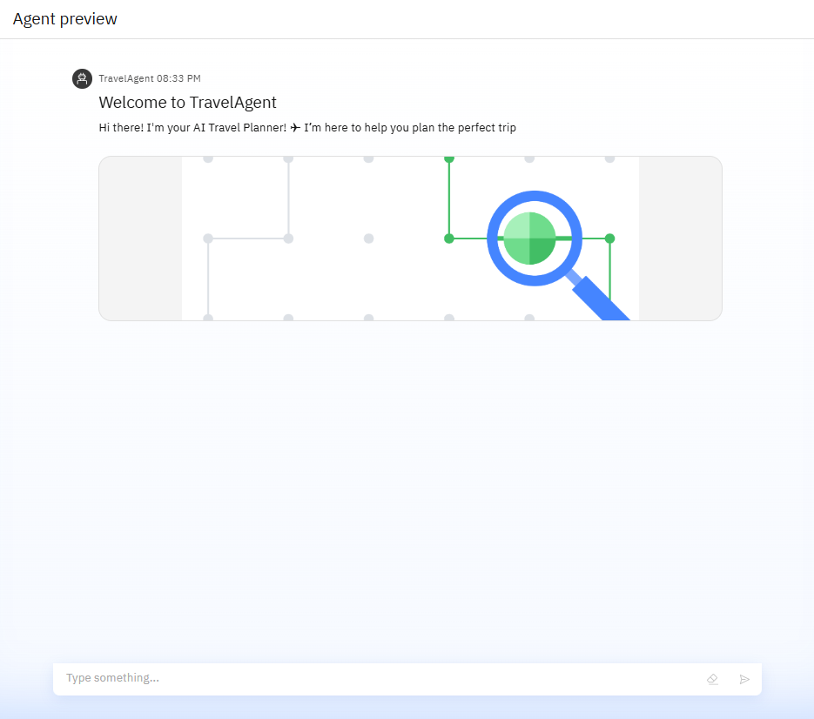
Results

Slide 9
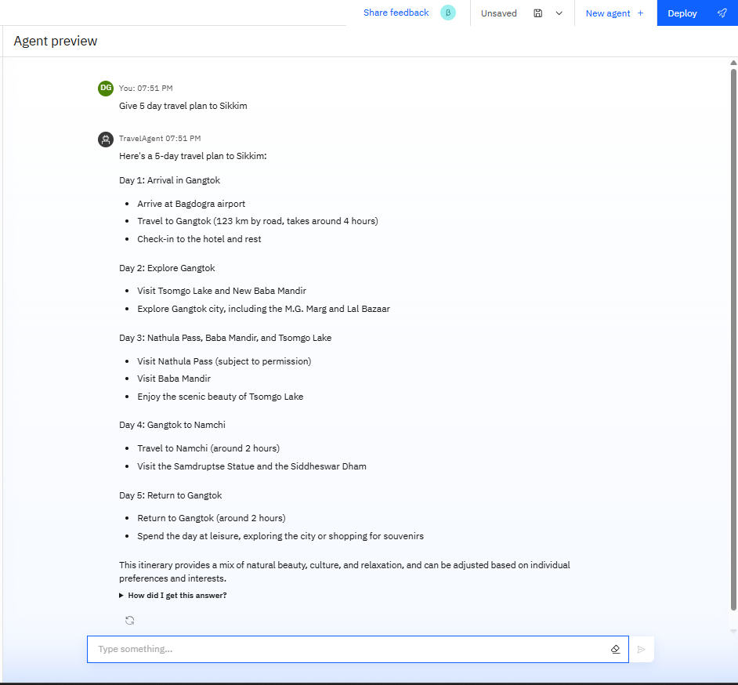
Results

Slide 10
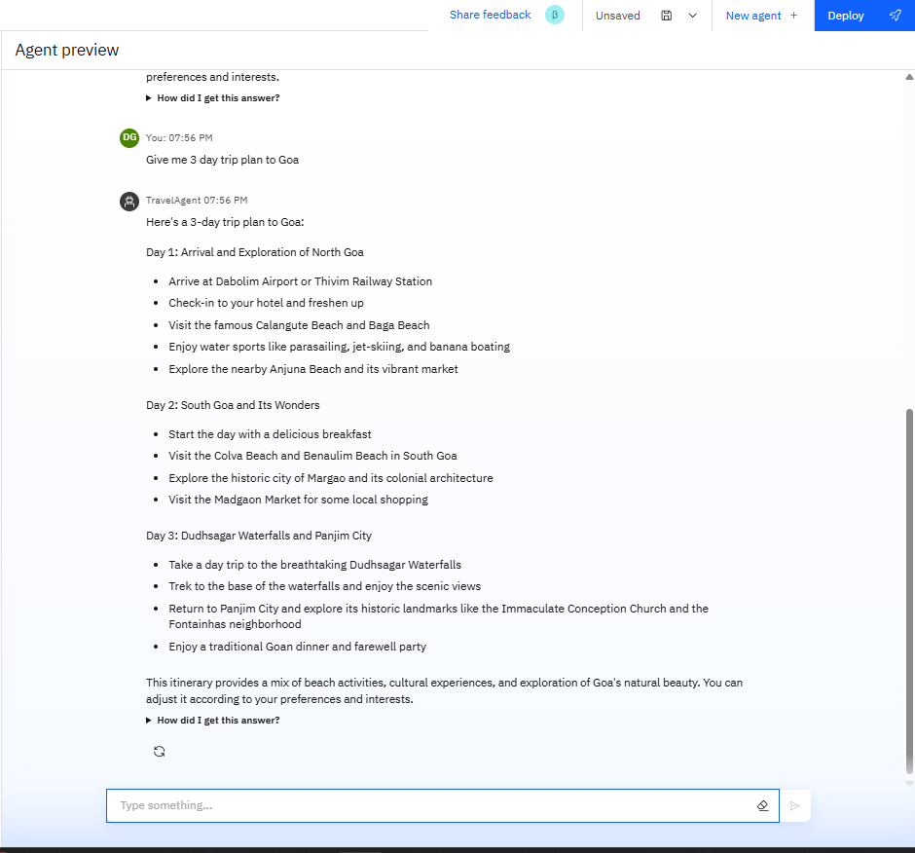
Results

Slide 11
Results
Deployed AI Agent

Slide 12
Conclusion
The AI-powered Travel Planner Agent simplifies and enhances the travel planning process by delivering personalized, real-time, and optimized solutions. By integrating transport, accommodation, weather updates, maps, and local guides into a single intelligent platform, it eliminates the need for multiple tools and manual planning. This smart assistant not only improves efficiency and convenience but also ensures a smooth and enjoyable travel experience tailored to each user's needs.

Slide 13
Future scope
Voice Assistant Integration – Enable voice-based trip planning using NLP for hands-free interaction.
AI Learning & Personalization – Use machine learning to improve recommendations over time based on user feedback and behavior.
Multilingual Support – Expand accessibility by supporting regional and international languages.
Calendar & Email Sync – Auto-sync with user calendars and emails to manage schedules and bookings seamlessly.
AR/VR Integration – Offer virtual tours of destinations for better decision-making.
Smart Packing & Budget Assistant – Add features that suggest what to pack and track expenses during the trip.
Enhanced Security Features – Include travel advisories, safety tips, and emergency contact support based on location.

Slide 14
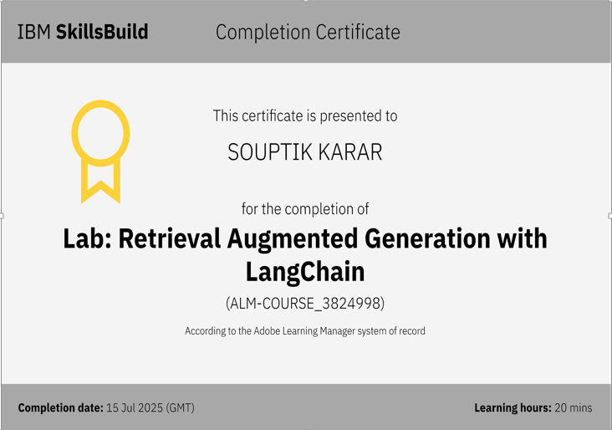
IBM Certifications

Slide 15
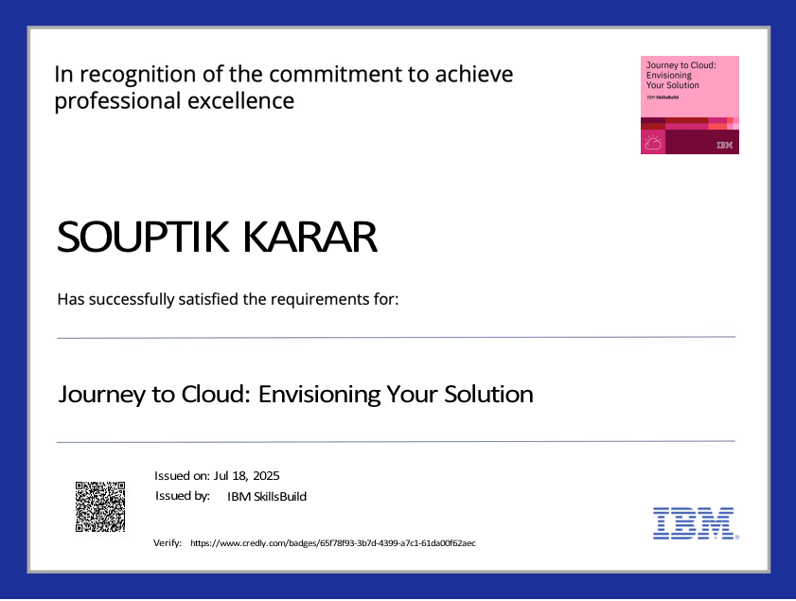

Slide 16
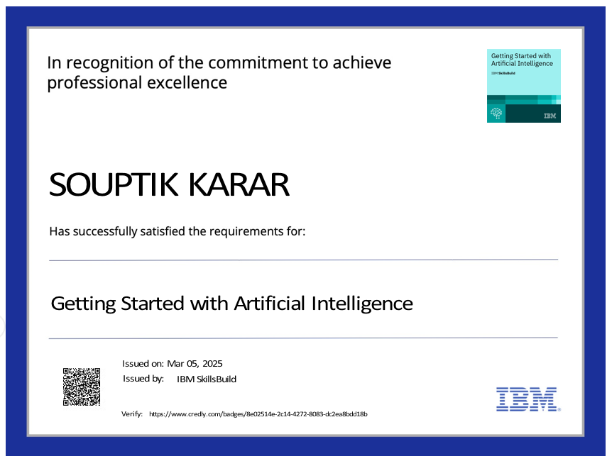

Slide 17
GitHub Link
GitHub Link: https://github.com/Souptikkarar/project.git

Slide 18
THANK YOU

